Slide 1

Object Detection using AI
This presentation explores the use of object detection in AI. It will cover the basics, the workflow, the different algorithms and models used, applications, and the challenges associated with object detection.
Prepared By: [ 22BECE30427 ] ANAJALEE SHANIYARA
[ 22BECE30444 ] VISHWA SONI

Slide 2
Introduction to Object Detection
What is Object Detection?
How it Works
Object detection using AI refers to the process of identifying and locating objects within an image or video. This involves recognizing objects and determining their positions.
AI models analyze images to identify and locate objects, typically by drawing bounding boxes around them.

Slide 3






Workflow of Object Detection
Image Input
The AI model receives an image or video frame as input.
Preprocessing
The image is prepared to match the model's input requirements.
Feature Extraction
Deep learning models like CNNs extract relevant features from the image.
Object Classification
The model classifies the extracted features into known objects.
Bounding Box Regression
The model predicts the location of each object by drawing bounding boxes.
Output
The model outputs the image with bounding boxes, class labels, and confidence scores.

Slide 4

Popular Object Detection Algorithms
1
YOLO
A real-time object detection model known for its speed and accuracy.
2
Faster R-CNN
A region-based CNN model that first proposes regions of interest (ROIs) and then classifies them.
3
SSD
Another real-time detector that can process multiple objects in images with different sizes.
4
RetinaNet
Known for its ability to handle class imbalance, where many of the background regions of an image aren't part of any object.

Slide 5
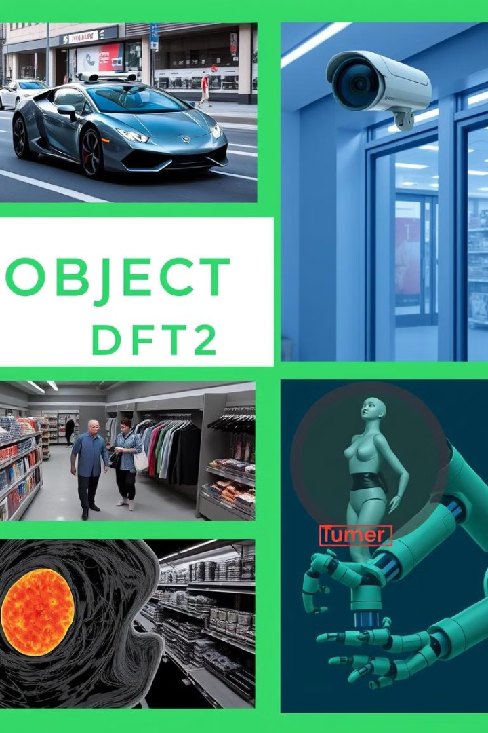
Applications of Object Detection
Autonomous Vehicles
Detecting pedestrians, other vehicles, traffic signs, and obstacles to enable safe navigation.
Security and Surveillance
Identifying suspicious activities, unauthorized access, or specific objects in CCTV footage.
Retail
Analyzing customer behavior, detecting products, or monitoring inventory.
Medical Imaging
Detecting anomalies or objects (e.g., tumors or organs) within medical images like X-rays or MRIs.

Slide 6
Drawbacks of Object Detection
Data Dependence
1
Requires large, labeled datasets, which can be time-consuming and costly to collect.
2
High Computational Power
Demands powerful hardware for training and real-time inference, making it expensive to implement.
Environmental Sensitivity
3
Struggles in varying lighting, weather conditions, or cluttered backgrounds, affecting accuracy.
4
False Positives/Negatives
Can misidentify objects or miss critical ones, especially in safety-critical applications.
Difficulty with Small Objects
5
Struggles to detect small objects, especially in crowded or low-resolution images.
6
Class Imbalance
Can be biased towards overrepresented classes, reducing accuracy for rare objects.
Real-Time Processing
7
May not meet real-time performance requirements, causing delays in dynamic environments.
8
Poor Generalization
Models may not perform well on new, unseen conditions or data types without retraining.

Slide 7





Future of Object Detection
Improved Accuracy
1
Advancements in algorithms and models are leading to more accurate object detection.
2
Enhanced Robustness
Efforts are being made to develop models less susceptible to environmental variations and noise.
3
Real-time Performance
Research focuses on developing real-time models that can handle complex tasks efficiently.
Increased Efficiency
4
Researchers are exploring more efficient training and inference techniques to reduce computational costs.
Wider Applications
5
Object detection is expected to play a significant role in a wide range of industries and applications in the future.

Slide 8





Impact of Object Detection
Transportation
Security
Retail
Object detection enables self-driving cars and improved traffic management.
It enhances security systems and surveillance capabilities, helping to prevent crime.
Object detection revolutionizes retail by optimizing inventory management and understanding customer behavior.
Healthcare
It assists in medical diagnosis, enabling faster and more accurate detection of diseases.

Slide 9

Object Detection Research
Data Augmentation and Synthetic Data
Real-time Inference
Addressing Class Imbalance
Exploring efficient methods for achieving real-time performance in object detection systems.
Improving Accuracy
Investigating effective data augmentation strategies and the use of synthetic data to overcome data limitations.
Research on techniques to overcome class imbalance challenges in object detection.
Focus on improving accuracy by developing more advanced algorithms and models.

Slide 10

Key Takeaways
1
2
Impactful Technology
Challenges Remain
Object detection is a transformative technology with numerous applications.
Object detection still faces challenges, including data dependency and computational cost.
3
Future Potential
Continued research and development will lead to improved accuracy and broader applications.

Slide 11
Thank You For Your Attention

